Slide 1
Virtual Campus
College Management Web Application
Developer : MANJUNATH M

Slide 2

Virtual Campus Logo

Slide 3
Synopsis
The Implementation of computers in each and every field of life made the Life much easier. The work became more efficient, accurate & less complex.
Our Project Comes Under The category Of Web Application Programs in Which I try to connect student & college Anytime, Anywhere With Proper Authentications and Administrative Tasks Computerization including Accounts Management Computerization. And also I tried hard to reduce the human efforts in “COLLEGE MANAGEMENT” By Making By Creating Smooth flow of work.

Slide 4
Aim Of This Project
This project is aimed to help the college institutions to overcome the problems they face in day to day life including the manually operational overhead work due to which the documents of the institutions cannot be processed for approvals and the problems of managing student database, employee’s database, student scholarship database, Accounts management, payroll management, student management etc…
This software is developed in such a manner that is easily manageable, time saving and mainly relieving one from manual works.

Slide 5
Architecture
The project has been planned to be having the view of distributed architecture, with centralized storage of the database. The application for the storage of the data has been planned. Using the constructs of MS-SQLserver and all the user interfaces have been designed using the asp.net technologies. The database connectivity is planned using the “SQL connection” methodology. The standards of security and data protective mechanism have been given a big choice for proper usage. The application takes care of different modules and their associated reports which are produced as per the applicable strategies and standards that are put forwarded by the administrative staff.
The entire project has been developed keeping in view of the distributed client server computing technology, in mind. The specifications have been normalized up to 3nf to eliminate all the anomalies that may arise due to the database transaction that are Executed by the general users and the organizational administration. The user interfaces Are browser specific to give distributed accessibility for the overall system, the internal database has been selected as MS-SQL server. The basic constructs of table spaces, Clusters and indexes have been exploited to provide higher consistency and reliability for the data storage. The MS-SQL server was a choice as it provides the constructs of high-level reliability and security. The total front end was dominated using the asp.net technologies. At all proper levels high care was taken to check that the system manages the data consistency with proper business rules or validations. the database connectivity was planned using the latest”SQL connection” technology provided by ©Microsoft corporation. The authentication and authorization was crosschecked at all the relevant stages.

Slide 6
Introduction To Project
The implementation of computers in each and every field of life made the life much easier. The work became more efficient, accurate & less complex.
The project has been planned to be having the view of distributed architecture, with centralized storage of the database. The application for the storage of the data has been planned. Using the constructs of MS-SQLserver and all the user interfaces have been designed using the asp.net technologies. The database connectivity is planned using the “SQL connection” methodology. The standards of security and data protective mechanism have been given a big choice for proper usage. The application takes care of different modules and their associated reports which are produced as per the applicable strategies and standards that are put forwarded by the administrative staff.
Main idea of my project is to connect student & college anytime, anywhere all 24/7 and 365 days a year, this is the network of connections only between the administrators, accounts department, students of the institution.

Slide 7
Introduction II
My project comes under the category of web application programs in which I tries to reduce the human efforts in “College Campus” and creating smooth flow of work anytime anywhere using proper authentication. It would be really my pleasure to introduce a new feature where i tried my hardest to make the communication between the college & the students anywhere anytime on the go.
This project is meant for creating a web application software to do the various college management tasks. it covers areas like registering student, storing the student information, updating student details, keeping track of student details, collecting fee and keeping track of fee collected in order to make audits easy, managing student scholarships, using student login student can get access to the features provided by the software and that access provides safest, secure access to his own database without conflicting the other.
Enhanced administrative features and enhanced security for a software and database, facility for the one click www connect & made scholarship registration easy & desirably management of scholarship is very easy.

Slide 8
Objectives
To create virtual presence of college anytime anywhere.
The aim of this project is to create separate network and environment for the particular institutions to build the connection between the student and the college by making separate user authentications to access the Network and to enjoy the features given to the student anytime anywhere 24/7 online.
To computerize the recording, processing and documentation of student data in college.
to computerize the payroll management and accounts department for the
Reliable and fast, secure medium of transactions.
To computerize the scholarship management system.

Slide 9
Objectives Continued…..
To computerize the notifications of the colleges.
To computerize document collections of students by admin.
To computerize manual leave letters.
To computerize notifications by colleges.
To computerize holiday settings.
To computerize administrative tasks.
To computerize accounts department tasks.
To computerize student tasks.

Slide 10
Programming Tools Used
Front End Tools
Windows 8.1 (Operating System).
Microsoft Visual Studio 2010.
Microsoft Visual Web Developer 2010 Express(Service Pack 1).
HTML 5
CSS 3.0
Back End Tools
SQL Server 2008 R2
IIS Express 8.0

Slide 11
Analysis Document SRS Document
Specific requirements
through this application administrator can do various administrative tasks built into this web application and accounts department admin can do various accounts related tasks on the go, student can login to this web application to meet his requirements which belongs to that student & college.
Moreover if anyone parents or general public want to access the site they can see the information on the homepage site.
Admin is the main authority to grant access to the services provide by this web application to the various groups like accounts department, students. And also admin is the one who add, delete, modify, track logins, and upload notifications.
Receive & reply to complaints etc…..
New features to students includes posting new complaints, requesting e-holiday, downloading notifications & uploading documents required by college etc…

Slide 12
Existing system
The current system works through a single system, where a client makes specific
Requests.
Limitations in existing systems:-
It is limited to a single system.
It is less user-friendly.
It is having lots of manual work (manual system does not mean that you are working with pen and paper, it also include working on spread sheets and other simple software's).
The present system is very less secure.
It is unable to generate different kinds of report.
It doesn’t have the mail and file upload feature.
Sometimes calculations may wrong while doing manually.

Slide 13
Solutions to these problems:-
The development of the new system contains the following activities, which try to automate the entire process keeping in view of the database integration approach.
User friendliness is provided in the application with various controls.
The system makes the overall project management much easier and flexible.
It can be accessed over the internet.
Various classes have been used to provide file upload and mail features.
There is no risk of data mismanagement at any level while the project development is under process.
Note : It provides high level of security using different protocols like https etc.

Slide 14
Feasibility study
Economic feasibility:-
Economic feasibility attempts 2 weigh the costs of developing and implementing a new system, against the benefits that would accrue from having the new system in place. This feasibility study gives the top management the economic justification for the new system.
A simple economic analysis which gives the actual comparison of costs and benefits are much more meaningful in this case. In addition, this proves to be a useful point of reference to compare actual costs as the project progresses. There could be various types of intangible benefits on account of automation. These could include increased customer satisfaction, improvement in product quality better decision making timeliness of information, expediting activities, improved accuracy of operations, better documentation and record keeping, faster retrieval of information, better employee morale.

Slide 15
Operational Feasibility
Operational feasibility:-
Proposed project is beneficial only if it can be turned into information systems that will meet the organizations operating requirements. Simply stated, this test of feasibility asks if the system will work when it is developed and installed. Are there major barriers to implementation? here are questions that will help test the operational feasibility of a project:
Proposed project is beneficial only if it can be turned into information systems that will meet the organizations operating requirements. Simply stated, this test of feasibility asks if the system will work when it is developed and installed.

Slide 16
System Requirements
Hardware Requirements
Software Requirements
CPU (Pentium IV/Dual Core/Higher)
Memory 256 MB Or 512MB+
Hard Disk : 40 GB/More.
Windows 98
Windows XP/Vista/7/8/8.1/10 Compatible.
HTML5, CSS 3.0
JavaScript, Visual C#.Net,Asp.Net,Sql Server 2008 R2.

Slide 17
About .NET Framework
The .NET Framework is a new computing platform that simplifies application development in the highly distributed environment of the Internet. The .NET Framework is designed to fulfill the following objectives:
To provide a consistent object-oriented programming environment whether object code is stored and executed locally, executed locally but Internet-distributed, or executed remotely.
To provide a code-execution environment that minimizes software deployment and versioning conflicts.
To provide a code-execution environment that guarantees safe execution of code, including code created by an unknown or semi-trusted third party.
To provide a code-execution environment that eliminates the performance problems of scripted or interpreted environments.
To make the developer experience consistent across widely varying types of applications, such as Windows-based applications and Web-based applications.

Slide 18
About Asp.Net
ASP.NET is a programming framework built on the common language runtime that can be used on a server to build powerful Web applications. ASP.NET offers several important advantages over previous Web development models:
Enhanced Performance.
World-Class Tool Support.
Power and Flexibility.
Simplicity
Manageability
Scalability and Availability
Customizability and Security..

Slide 19
About SQL Server 2008 R2
A database management, or DBMS, gives the user access to their data and helps them transform the data into information. Such database management systems include dBase,
paradox, IMS, SQL Server and SQL Server. These systems allow users to create, update and extract information from their database.
A database is a structured collection of data. Data refers to the characteristics of people, things and events. SQL Server stores each data item in its own fields. In SQL Server, the fields relating to a particular person, thing or event are bundled together to form a single complete unit of data, called a record (it can also be referred to as raw or an occurrence). Each record is made up of a number of fields. No two fields in a record can have the same field name.
During an SQL Server Database design project, the analysis of your business needs identifies all the fields or attributes of interest. If your business needs change over time, you define any additional fields or change the definition of existing fields.

Slide 20
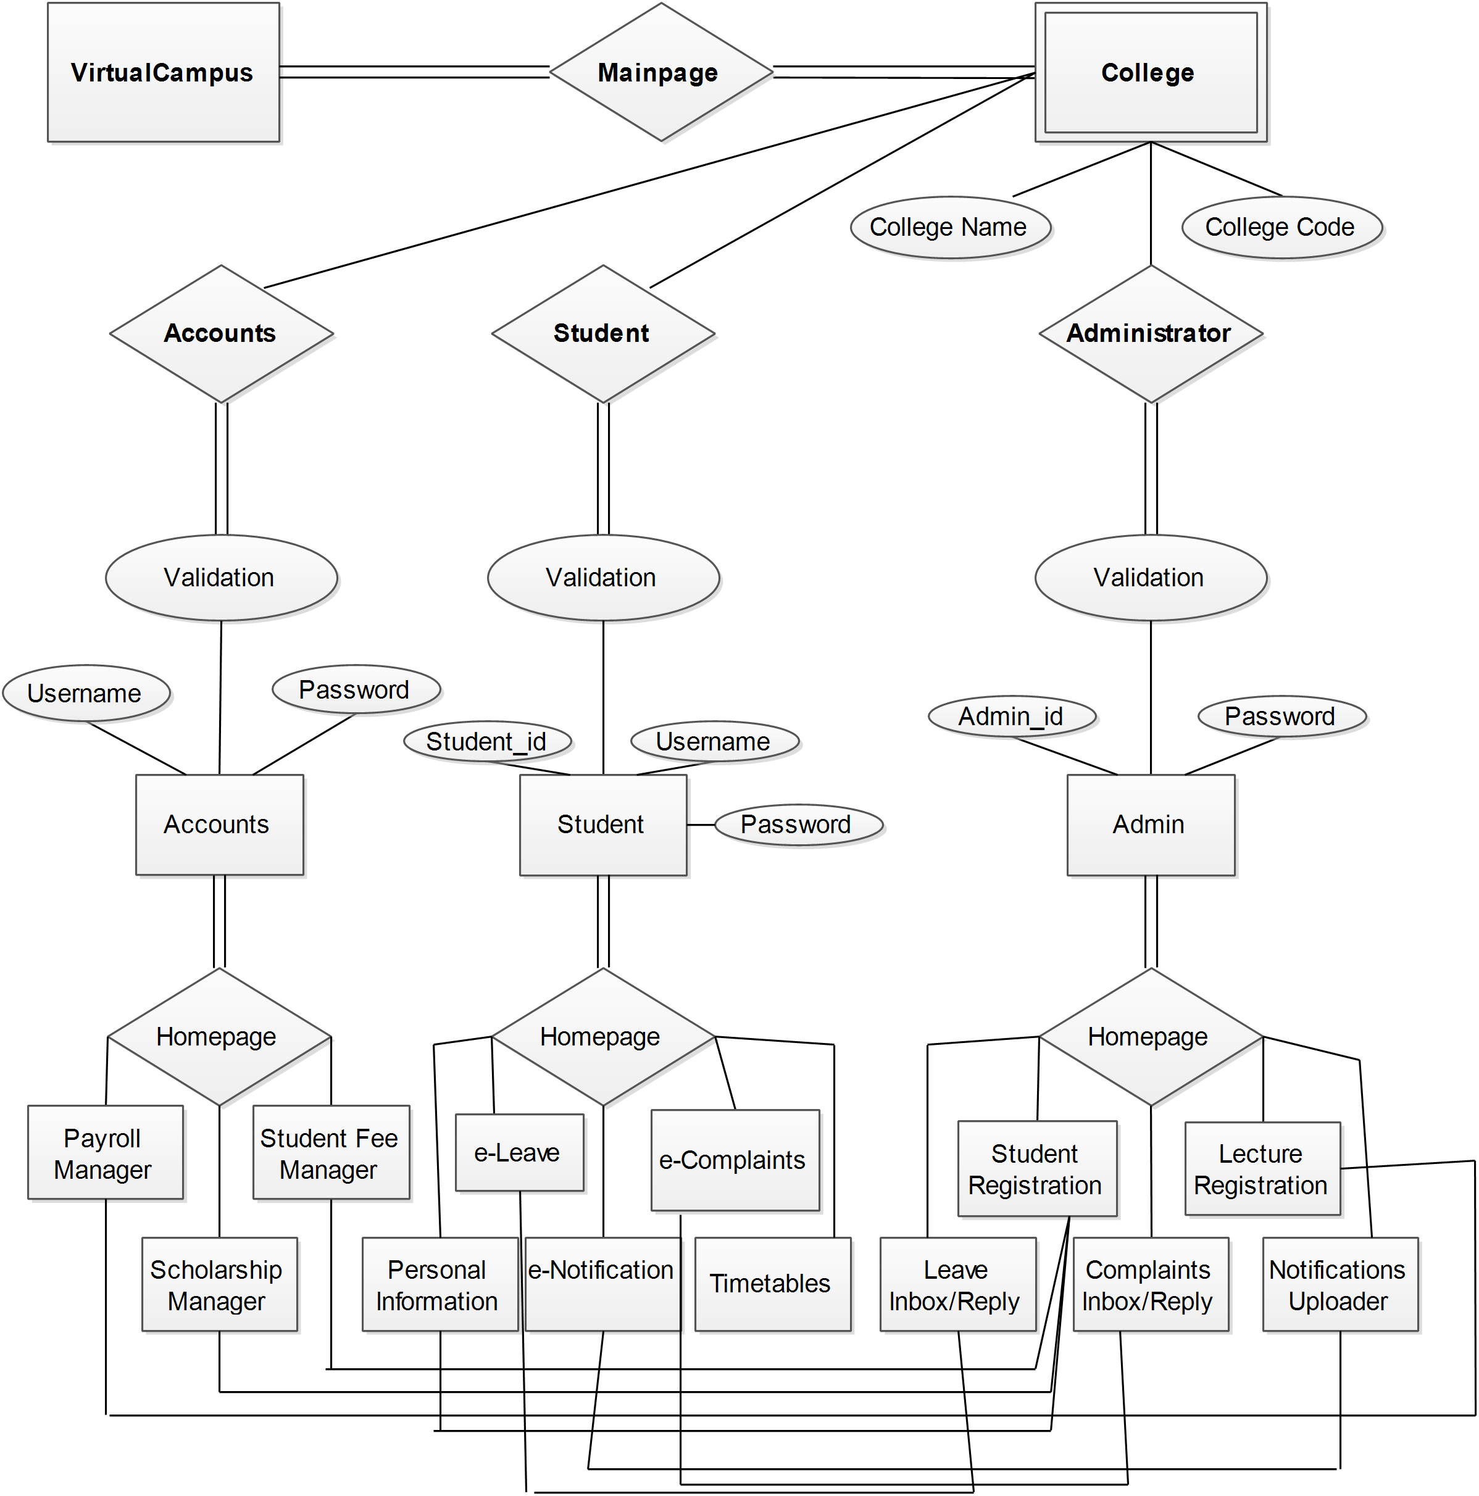
E-R Diagram Of The Project
Chen ERD Used.
Those Two Lines Are Just A line Connectors Showing The Relationship Path.

Slide 21
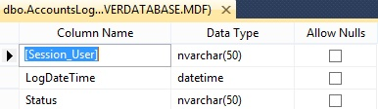
Sql Database Table UI

Slide 22
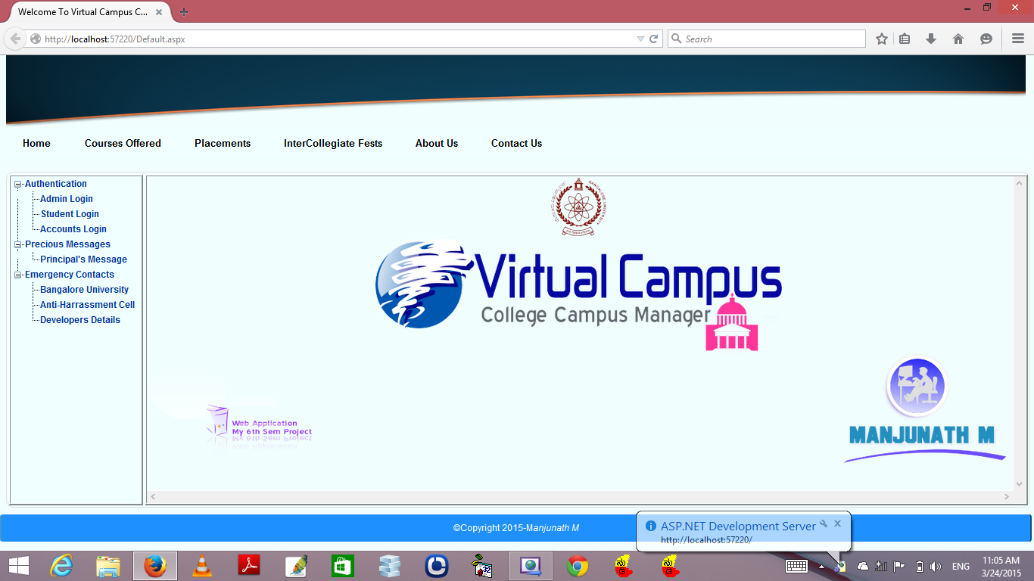
General User Homepage

Slide 23
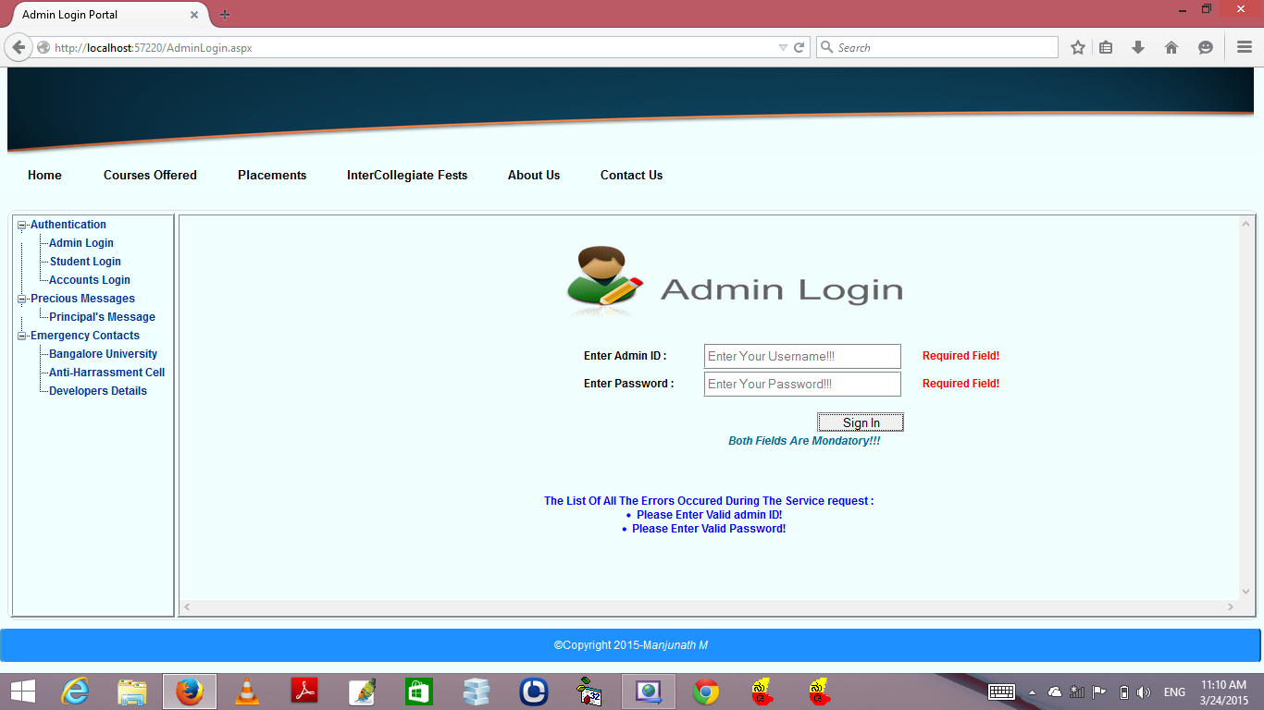
Admin Login Page

Slide 24
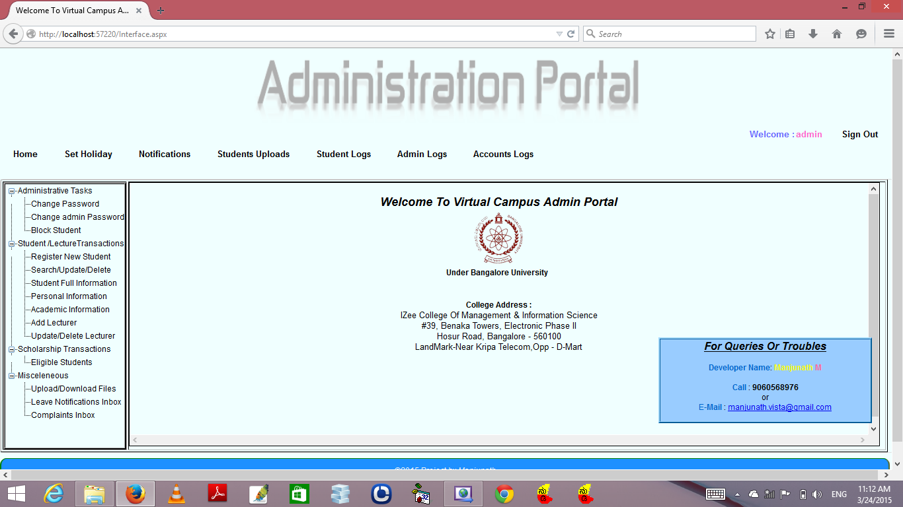
Administrator User Interface

Slide 25
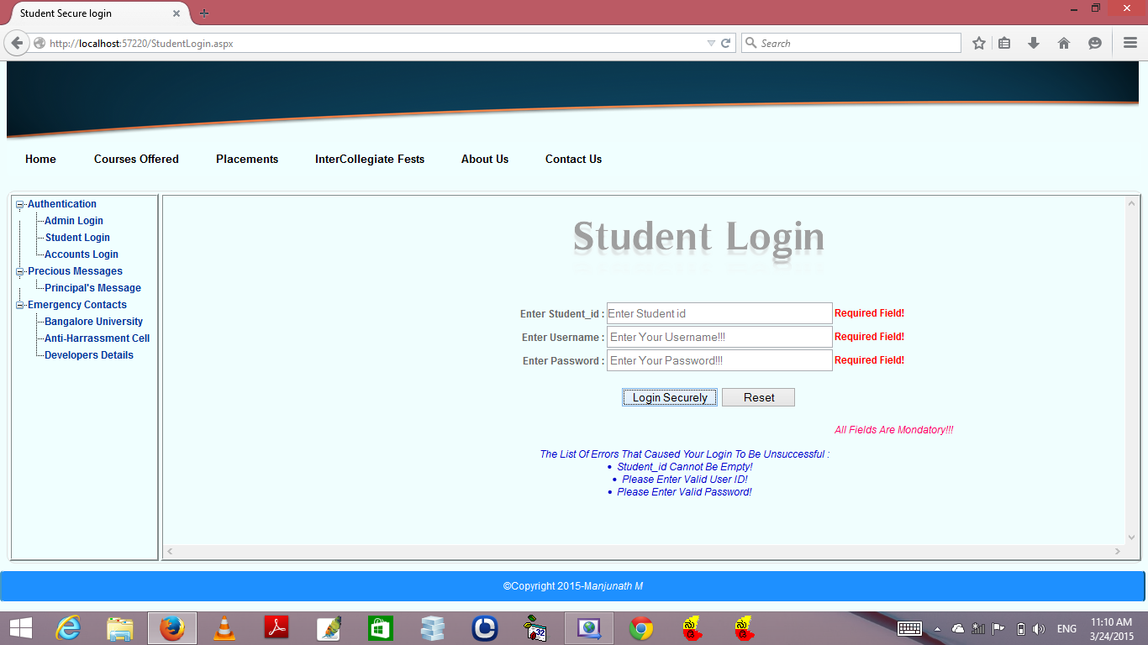
Student Login Page

Slide 26
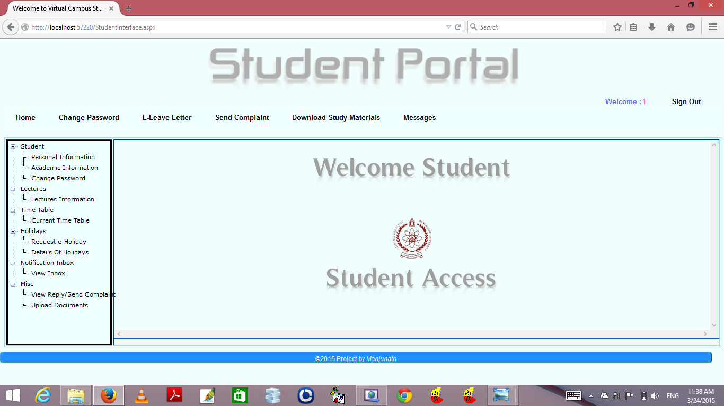
Student User Interface

Slide 27
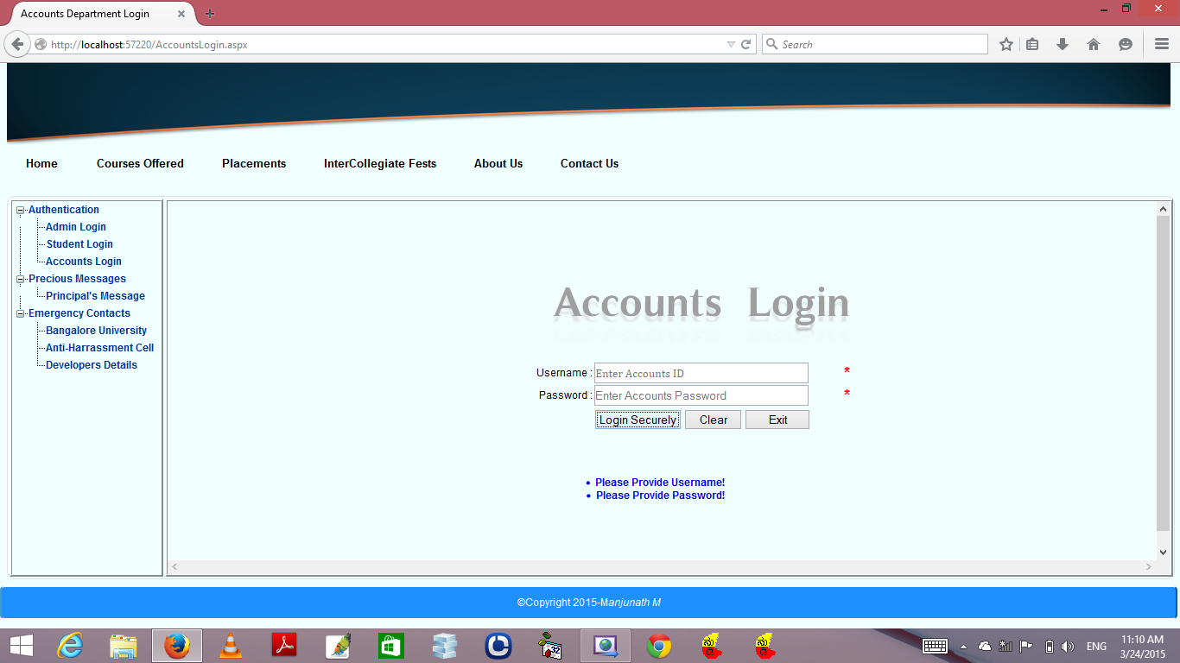
Accounts Login Page

Slide 28
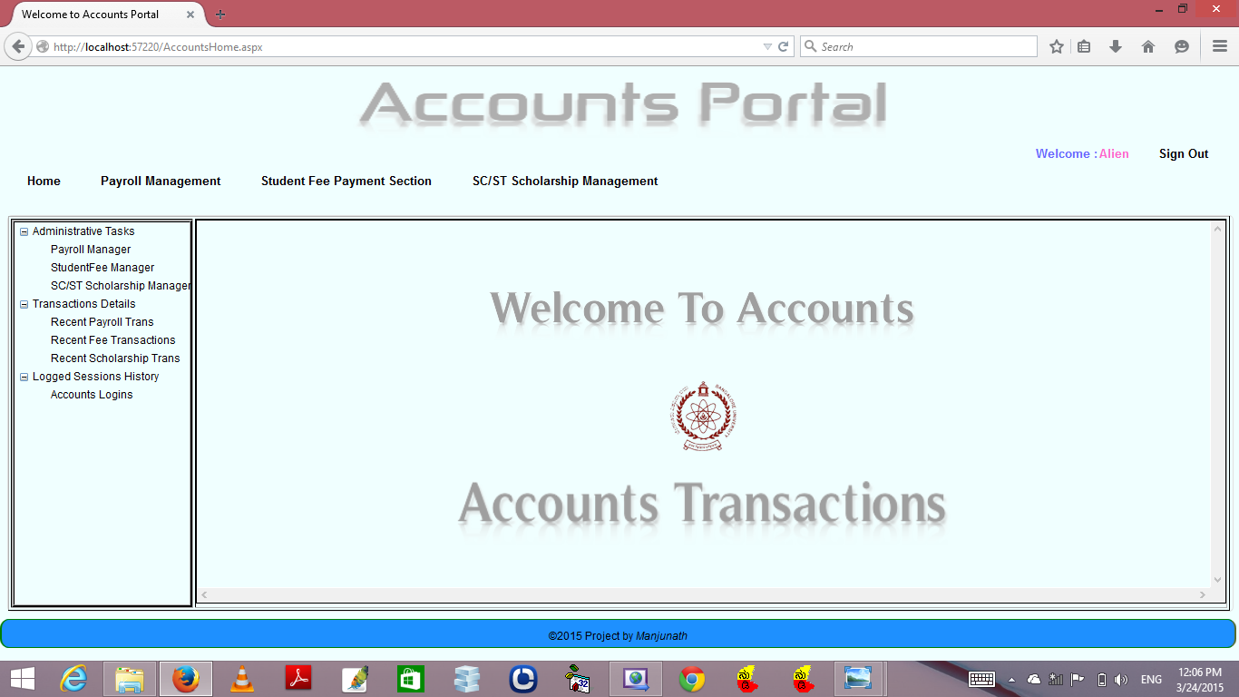
Accounts User Interface

Slide 29
Software Testing Modes
Testing Performs a very crucial role for the quality assurance and the reliability of the software. It deals with the details of the classes of tests which must be conducted to validate the functions, Performance, and the constraints.
This is achieved basically by the means of testing which plays a vital role in the development of the software.
The various low level testing which can be grouped on a broader sense are discussed Next.

Slide 30
Software Testing Modes
Unit Testing: Testing of each and every module individually is called unit testing. Each Module is designed And executed so that it works independently and generates some relative output. Unit testing of a module results In a set of individually executing modules that generates its independent output.

Slide 31
Software Testing Modes
Integration Testing : integration testing is one in which the modules are combined with one another To synchronize the outputs and co-ordinate the flow of control. Each module is coalesced with other module to Establish proper connectivity between the two projects this is done while generating the tables of the records and While generating the reports.

Slide 32
Software Testing Modes
Validation Testing : validation testing deals with testing that whether the validations are justified and The entire requirement are fulfillment logically as per the requirements. As the validations are designed according To requirement of the application an approach to the problem in a logical and relational manner. All the validation Testing have been done.

Slide 33
Software Testing Modes
System Testing: testing the whole system i.e. verifying and validating the whole source code to check if The system as a whole is executing is called System testing. The proposed system undergoes it under all conditions Called a successful system.

Slide 34
Software Testing Modes
Code Testing : The logic of the various program modules is tested in the module. Using the test cases, all Parts of the program are tested and identified. If a problem is encountered it is rectified. The Code was tested for Its efficiency and it was found that code is efficient and optimized.

Slide 35
Conclusion
I Have Tried My Maximum to Make This Project “COLLEGE MANAGEMENT” Called “VIRTUAL CAMPUS” at its Best, and I tried to connect all the features and make the project more user friendly and secure.
I Promise This Project Surely Make Managing Activities in college Easy And Reduces Human Effort And Make The Work flow very easy and reduces the time of tasks.
Once again I would love to thank everyone who helped me in Successful completion of this project.

Slide 36
Bibliography
A Complete Guide To INTERNET And WEB PROGRAMMING | By Devan N. Shah Dreamtech press
WEB PROGRAMMING in easy steps | By Srikanth.S Skyward publishers
C# TUTORIAL | By tutorialpoints.com
A Whitepaper | By Sybase iAnywhere
Mastering asp.NET with C# | A. Russell Jones
C# Web Services | Wrox
Learning Asp.NET | By Jesse liberty,Dan harwitz,Brian McDonald O’Reilly
Expert asp.NET(Advanced Application Design) | By Doiminic Selly,Andrew Troelson,Tom Bornaby aPress

Slide 37
Thank You Madam

